Slide 1

Digital Egypt Pioneers Initiative
DEPI - Google IT Support Professional
By:
Esraa Soliman Mubarak
Omnia Mohamed Mansour
Abdullah Fawzi Mohamed

Slide 2

CONTRIBUTIONS AND LEADERSHIP
Project Idea Originator:
I developed the original concept of the project, aimed at addressing critical challenges in [Tech Wave].
Leadership & Coordination:
I took the lead in organizing the project, delegating tasks, and ensuring smooth collaboration across all stages.
Presentation Creation:
I independently created the entire presentation, designed to effectively communicate our objectives, milestones, and outcomes.
Task Management:
I managed the distribution of tasks and monitored progress, ensuring the team met deadlines efficiently.
PRESENTED BY: omnia mohamed

Slide 3
Introduction
Problem Identification
Proposed Solutions
Centralized management
Agenda
Virtualization Implementation
Disaster Recovery Plan
Securing remote employees (OpenVPN)
Automation (PowerShell & Bash)
Monitoring Active Directory
Active Directory Replication Setup
Communication improvements (Slack)
Conclusion
Cost Management
Conclusion

Slide 4
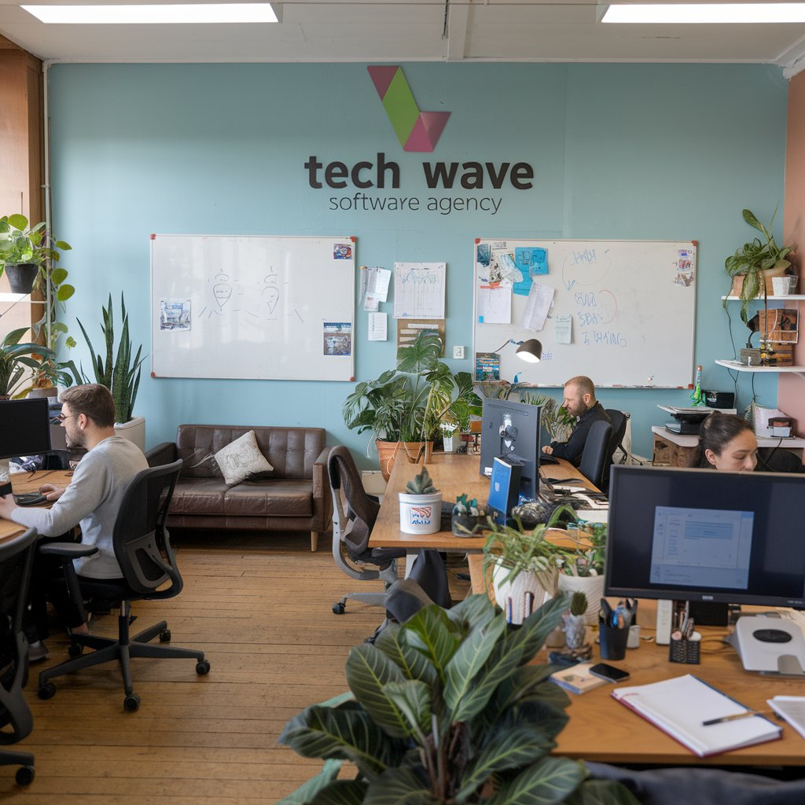
Digital Egypt Pioneers Initiative
Introduction
Company Overview:
Company Name: TechWave Solutions
Industry: Software Development
Size: Small-sized company with 20 employees
Departments:
IT Department: 1 admin
Development Team: 6 developers
Sales Team: 4 members
Human Resources (HR): 2 employees

Slide 5

Digital Egypt Pioneers Initiative
Lack of Centralized Management
Centralized Control
Windows Server
Security Risks for Remote Employees
Secure VPN Access
Problem Statement
No Disaster Recovery Plan
Disaster Recovery
Backup & Replication
Add more sub-ideas
OpenVPN on AWS
Limited Hardware Resources
Inefficient Communication
Unified Communication
Cost Efficiency
VMware Virtualization
Slack

Slide 6
Problem Statement
Growing IT Infrastructure Management Challenges:
As the company expands, managing the growing IT infrastructure has become increasingly difficult. The reliance on physical servers and manual processes has led to several inefficiencies:
System Management Issues:
Difficulty managing systems across different platforms (Windows).
Challenges managing both on-premises and cloud-based resources.
Lack of Centralized Communication:
No unified platform for effective employee collaboration.
Inefficient Processes:
Manual system maintenance leads to increased time and effort.
Scalability and Resource Constraints:
Limited physical infrastructure to scale up operations.
Data Security and Availability Concerns:
Ensuring data security across departments.
Maintaining high system availability with minimal downtime.
Digital Egypt Pioneers Initiative

Slide 7
Key Technical Challenges and Proposed Solutions
Virtualization Implementation:
Challenge: Optimizing resource utilization across multiple platforms (Windows, Linux).
Solution: Deploy VMware or a similar hypervisor to manage virtual machines (VMs), increasing scalability and operational flexibility.
Unified Communication Channel:
Challenge: Lack of a unified platform for communication.
Solution: Implement Slack as the central communication hub for messaging, file sharing, and team collaboration.
Centralized User Management:
Challenge: Difficulty in managing user access across systems.
Solution: Implement Active Directory (AD) for centralized authentication, improving security and access control.
Hybrid Infrastructure Management:
Challenge: Managing on-premises and cloud resources effectively.
Solution: Integrate on-premises systems with AWS for scalability and flexibility while reducing costs.
Digital Egypt Pioneers Initiative

Slide 8
Key Technical Challenges and Proposed Solutions
VPN Setup for Remote Employees:Challenge:
Challenge: Securing remote access for employees.
Solution: Implement OpenVPN to encrypt employee connections and ensure secure remote access.
Automation:
Challenge: Manual processes are time-consuming and prone to errors.
Solution: Use PowerShell (Windows) and Bash (Linux) to automate routine tasks, such as updates, backups, and system maintenance.
Backup and Disaster Recovery:
Challenge: Ensuring data protection and continuity in case of failure or attack.
Solution: Regular backups to AWS S3, and a comprehensive disaster recovery plan, ensuring data integrity and rapid recovery.
Security Measures:
Challenge: Protecting against cyber threats.
Solution: Implement data encryption, configure firewalls, and conduct regular security audits to prevent security breaches.
Digital Egypt Pioneers Initiative

Slide 9
Key Technical Challenges and Proposed Solutions
Performance Monitoring and Optimization:
Challenge: Ensuring optimal system performance.
Solution: Use AWS CloudWatch to monitor system performance, optimize resource allocation, and ensure operational efficiency.
Testing and Monitoring:
Challenge: Detecting issues early and ensuring system reliability.
Solution: Use monitoring tools like Nagios or AWS CloudWatch to identify issues and maintain high availability.
Cost Management and Optimization:
Challenge: Managing IT expenses while ensuring optimal resource utilization.
Solution: Conduct cost assessments regularly and implement cost-saving strategies like AWS Reserved Instances.
Digital Egypt Pioneers Initiative

Slide 10


Centralized User Management:
Benefit:
Simplifies managing employee access, improving security and efficiency.
What we did:
Implemented Active Directory for centralized user management across the organization.
Created Organizational Units (OUs) and grouped users by department (IT, Development, Sales, HR) for tailored policy application.
Link & Explanation:
Omnia
Digital Egypt Pioneers Initiative

Slide 11

Virtualization Implementation
Benefit:
Cost savings by reducing hardware expenses and enhancing server utilization.
Scalability to easily add or remove virtual machines as needed.
Improved disaster recovery capabilities through flexible backup and restore options.
What We Did:
Utilized VMware and KVM to virtualize physical servers, creating multiple virtual machines (VMs) for hosting applications and databases.
Consolidated several physical servers into fewer high-performance machines running multiple VMs.
Link & Explanation:
Abdullah
Digital Egypt Pioneers Initiative

Slide 12
Disaster Recovery plan
Objective:
To ensure business continuity and data integrity in the event of system failures, natural disasters, or cyber threats.
Regular Backups
We conduct routine backups of our critical data, both locally and on AWS Cloud. This practice safeguards us against potential data loss. By utilizing AWS Backup, we can centralize our cloud backup management, ensuring that we have reliable copies of our data available when needed.
Active Directory Replication
Regular replication of Active Directory is essential. This process ensures that our user access and security policies remain intact during outages. It’s about maintaining continuity so that everyone can access what they need, even if we face a disruption.
Explanation:
Omnia
Digital Egypt Pioneers Initiative

Slide 13
Disaster Recovery plan
Patch Updates:
We’ve established a schedule for timely patch updates across all our systems and applications. Keeping our software up to date is crucial for reducing vulnerabilities. By addressing these updates regularly, we minimize the risk of security breaches.
Monitoring:
Our plan includes continuous monitoring of system performance and backups. This ensures that any irregularities, such as system failures or unauthorized activities, are detected promptly. Regular checks on backup and replication processes help maintain data integrity, ensuring quick recovery in case of any disaster.
VPN Security:
Finally, our VPN infrastructure plays a key role in our disaster recovery plan. Ensuring secure remote access for employees during disruptions is a priority. This way, everyone can stay connected and continue working effectively, regardless of the circumstances.
Explanation:
Omnia
Digital Egypt Pioneers Initiative

Slide 14

VPN Implementation
Benefit:
Provides secure remote access for employees with encrypted connections.
What We Did:
Hosted OpenVPN on AWS Cloud: Established a secure VPN solution for encrypted connections between employees’ devices and company infrastructure.
Key Features:
IEncryption: Protects data in transit using SSL/TLS.
Scalability: Easily scale VPN users as the organization expands.
Multi-Platform Support: Compatible with Windows, Linux, macOS, and mobile devices.
Cost-Effective: Flexible pay-as-you-go model via AWS, minimizing upfront infrastructure costs.
Link & Explanation:
Esraa
Digital Egypt Pioneers Initiative

Slide 15
Automation
Patching and Updating Servers:
Automated patch management for both Windows and Linux systems to keep them up-to-date and secure without manual intervention.
Automated Backups:
Implemented automatic backups both locally and on AWS Cloud, ensuring data is protected and easily recoverable in case of system failure.
System Performance Monitoring:
Deployed continuous monitoring tools to track system performance, allowing us to address any potential issues before they impact operations.
User Management with Active Directory:
Automated the process of adding users to specific groups and Organizational Units (OUs) within Active Directory, improving management and applying role-based access controls.
Link & Explanation:
Esraa
Digital Egypt Pioneers Initiative

Slide 16
Monitoring Active Directory
Benefit:
Cost savings by reducing hardware expenses and enhancing server utilization.
Scalability to easily add or remove virtual machines as needed.
Improved disaster recovery capabilities through flexible backup and restore options.
What We Did:
Implemented Monitoring Tools:
Utilized Event Viewer to monitor system performance (CPU, RAM, network).
Configured Group Policy:
Configured security policies, monitored user logins, and tracked system performance using Performance Monitor.
Monitored Event Logs:
Set up Event Viewer to track login activities and security events.
Maintained Regular Updates:
Ensured timely system and security updates.
Analyzed Usage Logs:
Enabled detailed reporting on work hours and activities through log analysis.
Digital Egypt Pioneers Initiative
Link & Explanation:
Abdullah

Slide 17
Active Directory replication Setup
Objective:
Set up Active Directory replication between two Domain Controllers (DCs) for high availability and fault tolerance.
What We Did:
Installed and promoted a secondary server as a Domain Controller.
Configured AD Sites and Services for replication.
Verified and monitored replication status using repadmin and Event Viewer.
Benefit:
Ensures continuous authentication and domain management even if one DC fails.
Link & Explanation:
Esraa
Digital Egypt Pioneers Initiative

Slide 18
Unified Communication platform
What we did:
Set up Slack for unified communication across departments (IT, Development, HR, Sales).
Benefit:
Centralized communication platform.
Improves collaboration and workflow.
Secure and accessible from anywhere.
Link & Explanation:
Abdullah
Digital Egypt Pioneers Initiative

Slide 19



Cost Management and Optimization
Digital Egypt Pioneers Initiative
SERVICE
COST
DESCRIPTION
RENEWAL DATE
NON-MONTHLY SUBSCRIPTIONS
AWS Backup (S3)
$5.00
Cloud backup for data storage
Monthly
-----
AWS EC2 Instances
$15.00
Compute capacity on the cloud
Monthly
-----
AWS OpenVPN
$60.00
Secure remote access
Monthly
-----
No renewal needed (perpetual license, updates may be required every 1-2 years).
VMWare License
$199
Virtualization for server management
-----
Slack (Standard)
$145.00
Team communication (20 users)
Monthly
-----
Windows Server License
$972
Centralized user and device management
-----
No renewal needed (perpetual license).
Windows 11 License
$199.99
Client Access Licenses (CALs) for each user or device.
-----
No renewal needed (perpetual license).

Slide 20
Conclusion
Digital Egypt Pioneers Initiative
By implementing centralized user management, automation, hybrid infrastructure, and enhanced communication tools, the company can improve its IT efficiency, reduce costs, and scale effectively.
The solution will address the immediate challenges while preparing the infrastructure for future growth.

Slide 21
Resources
Digital Egypt Pioneers Initiative
Assigned Tasks | Automation
Unified Communication Channel | Centralized User Management
Windows Server Replication | VPN Setup
Virtualization Implementation | Testing and Monitoring

Slide 22



Do you have
any questions?
Esraa
esraa.soliman.mubarak@gmail.com
Feel free to reach out!
Omnia
momnia475@gmail.com
Abdullah
abdallhfawzi2022@gmail.com

